Slide 1

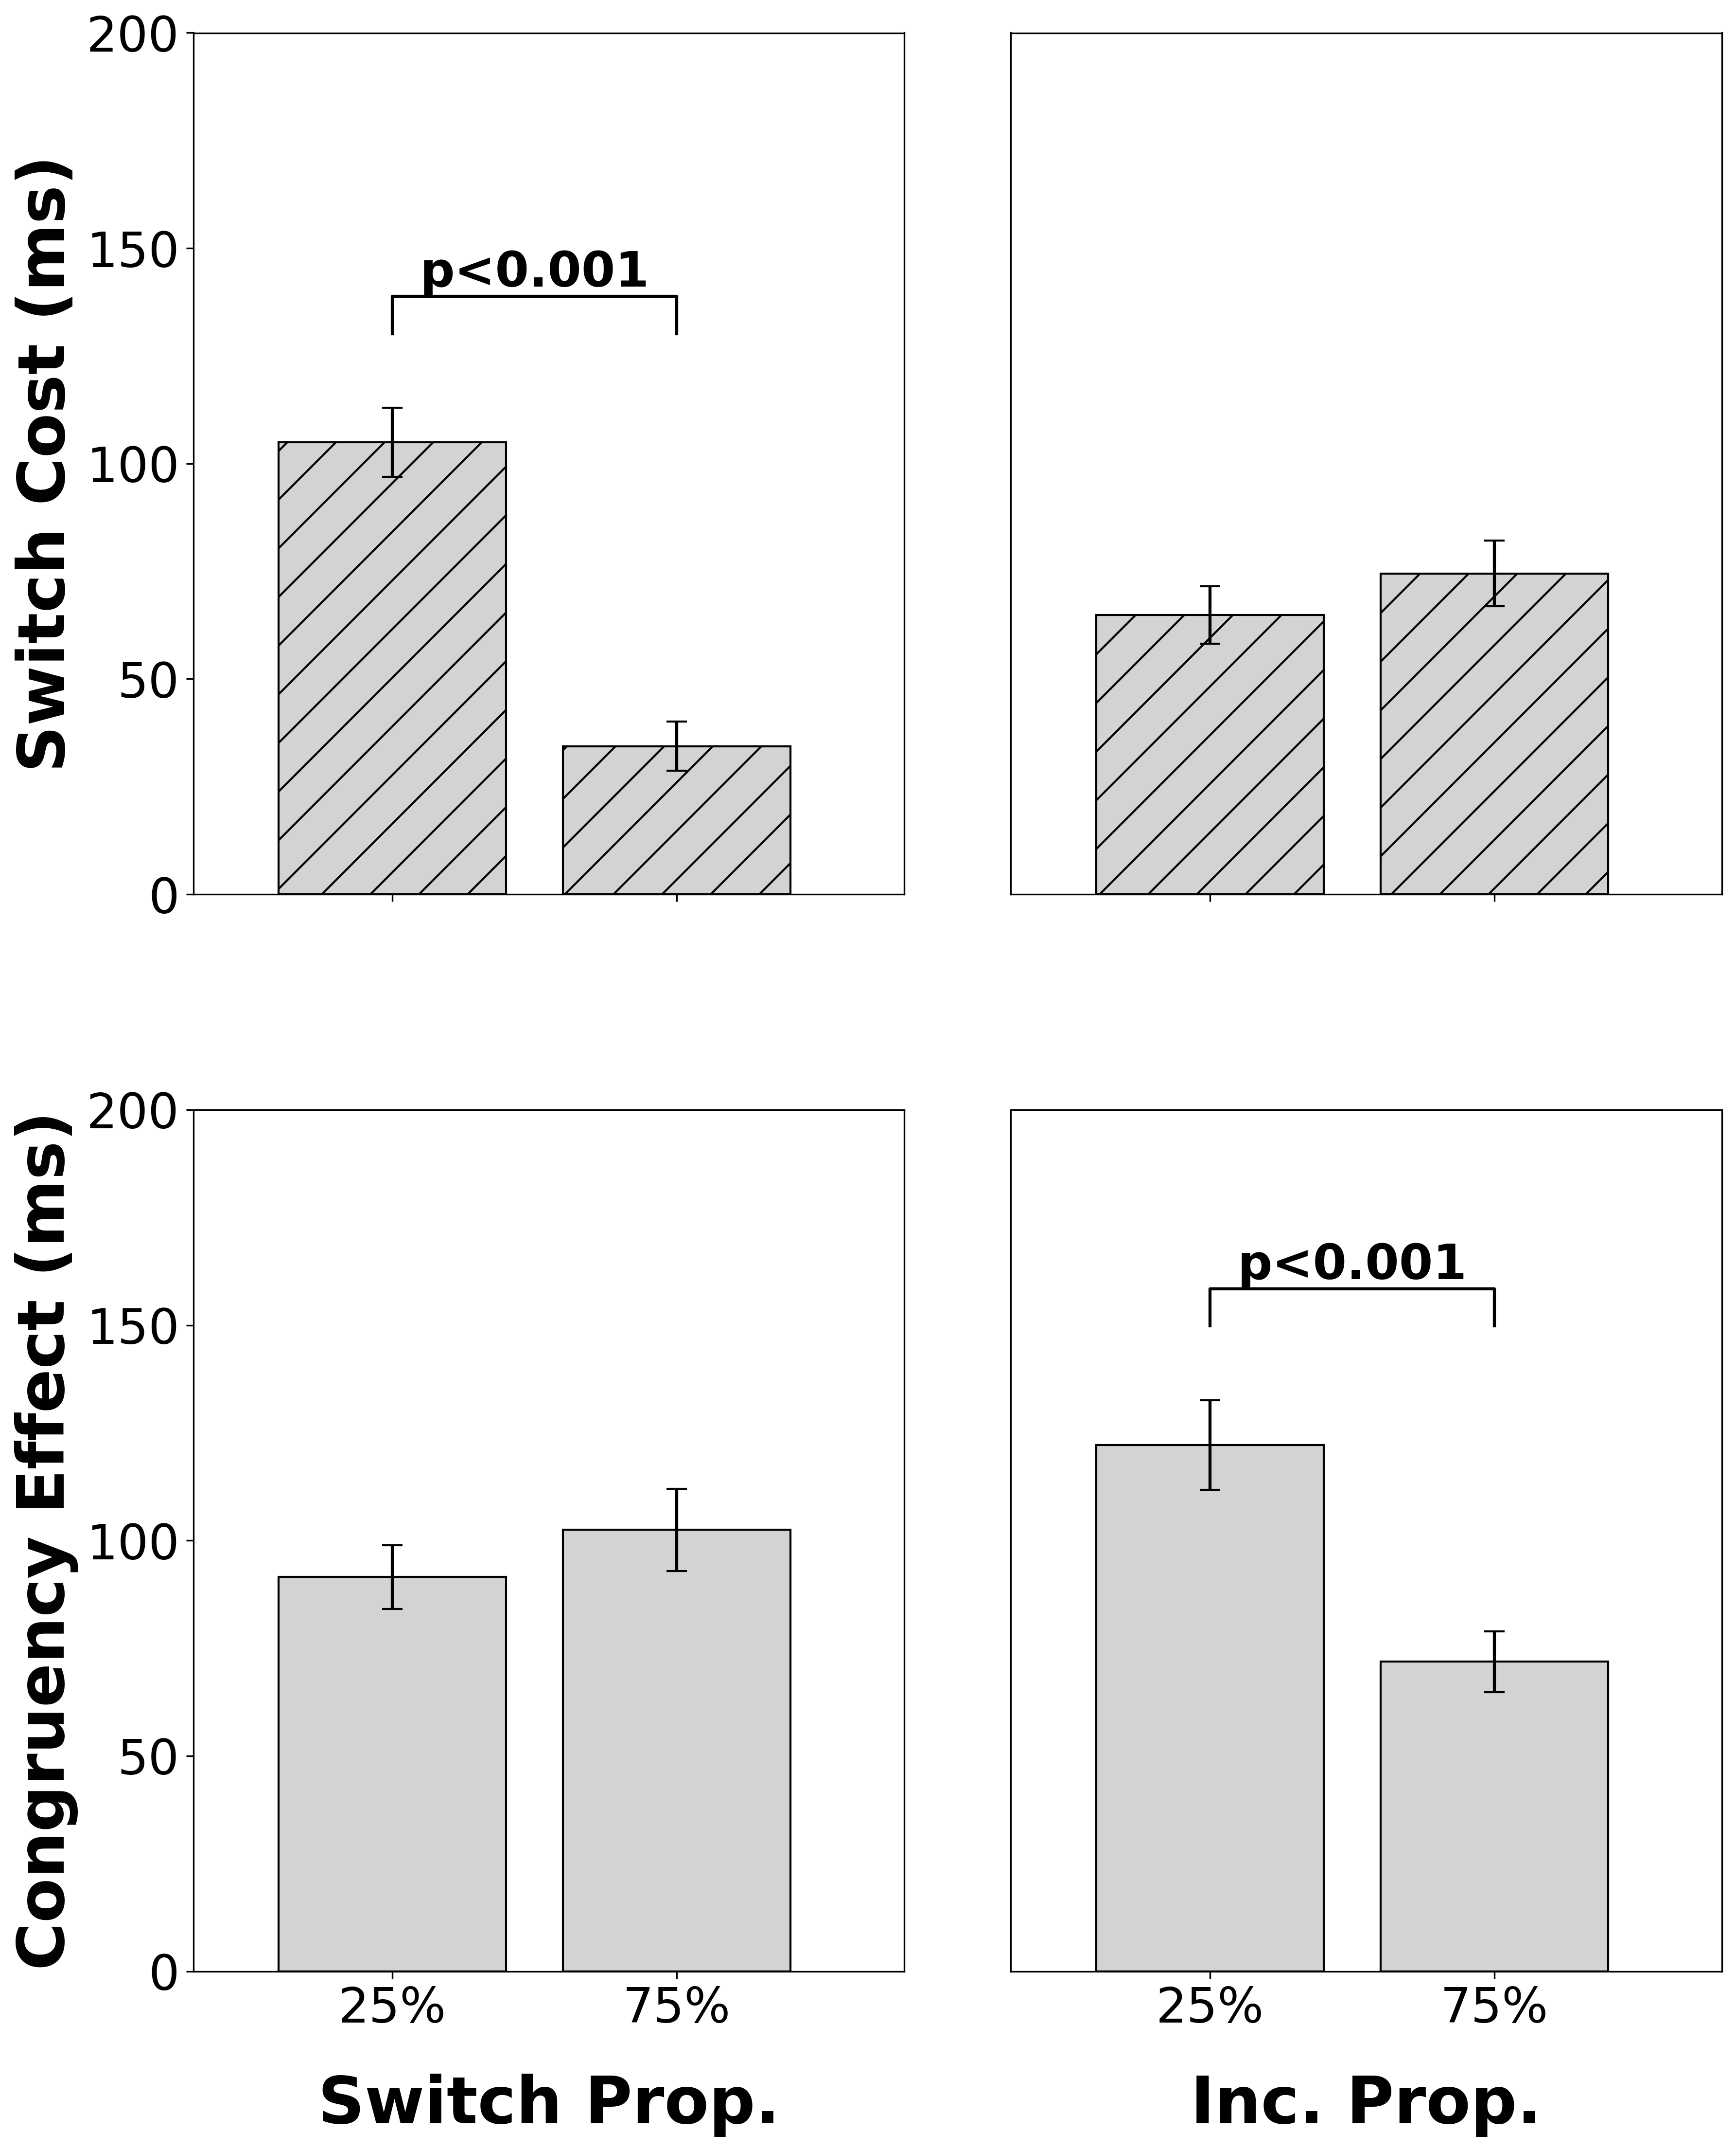
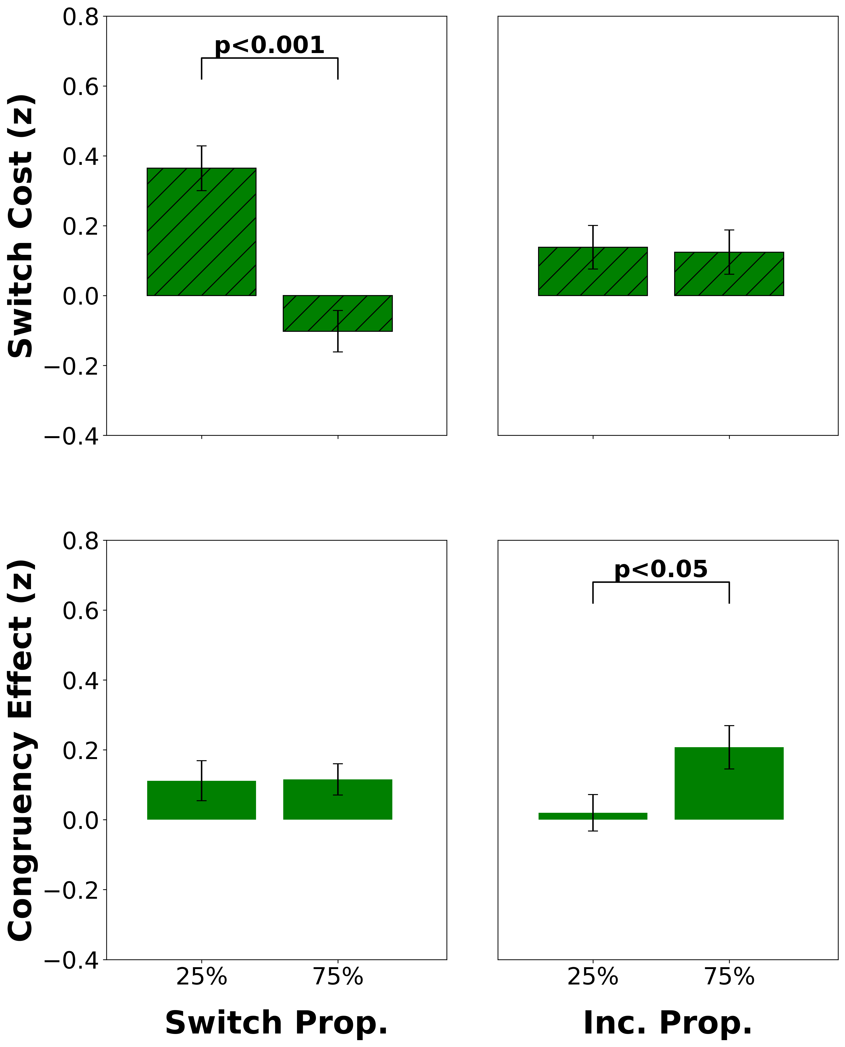
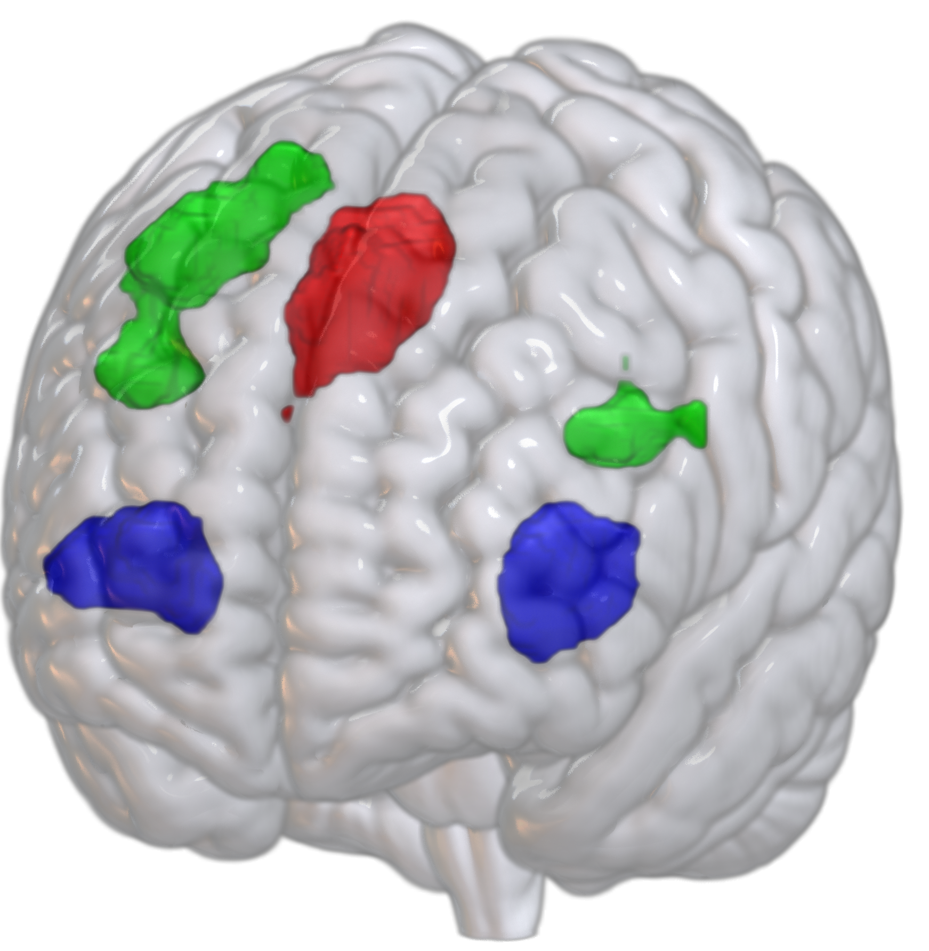
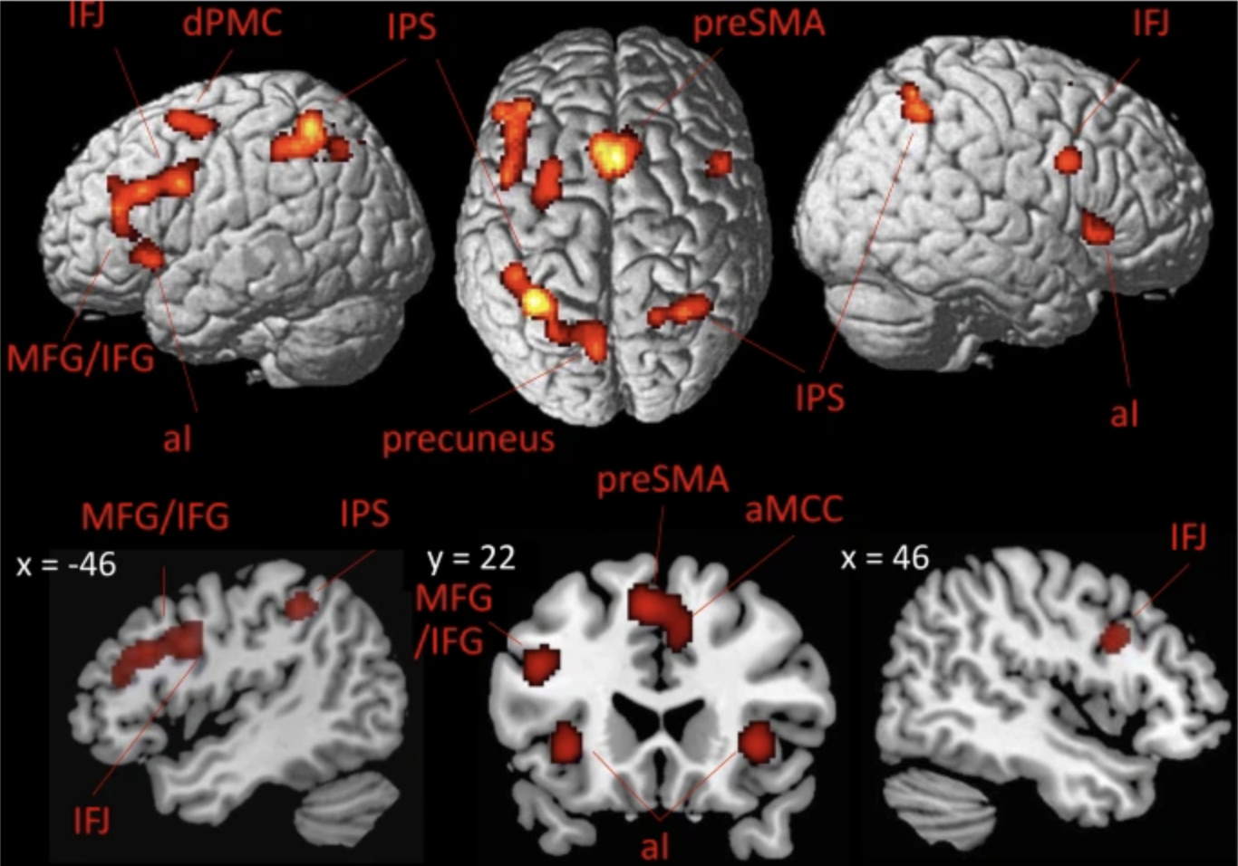
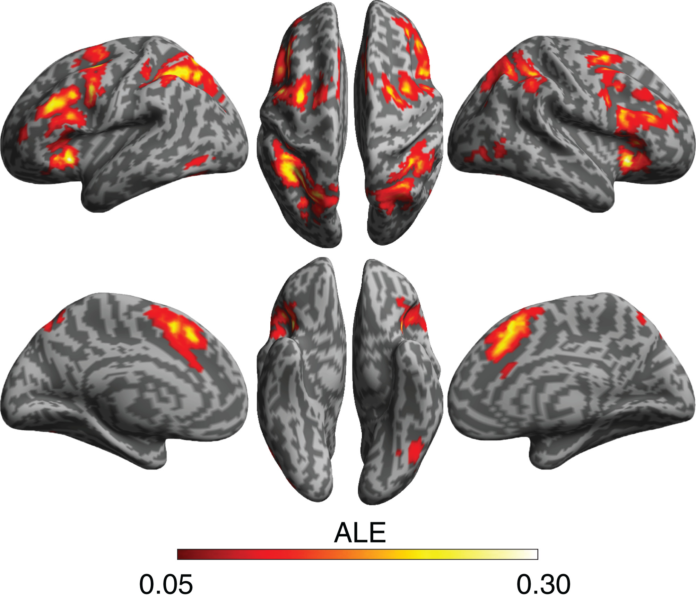
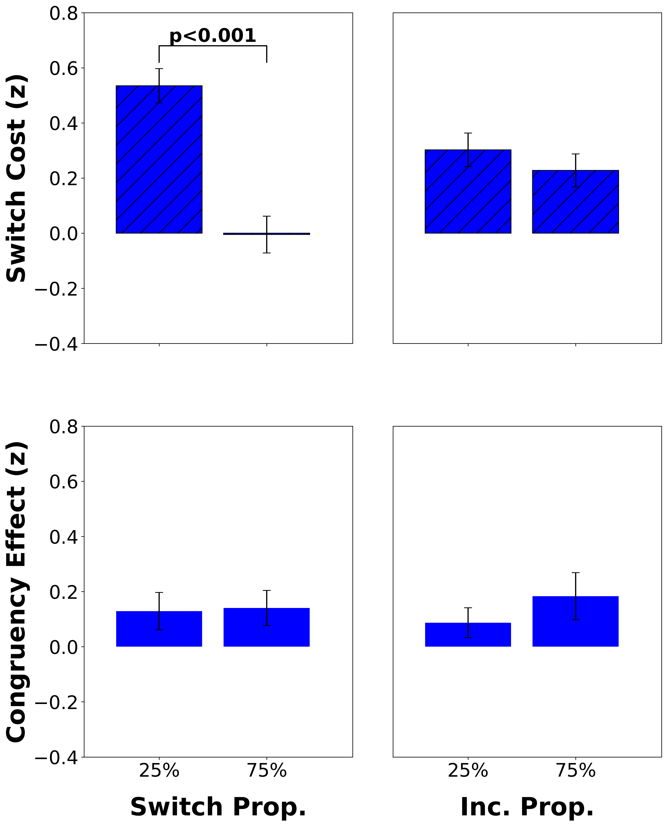
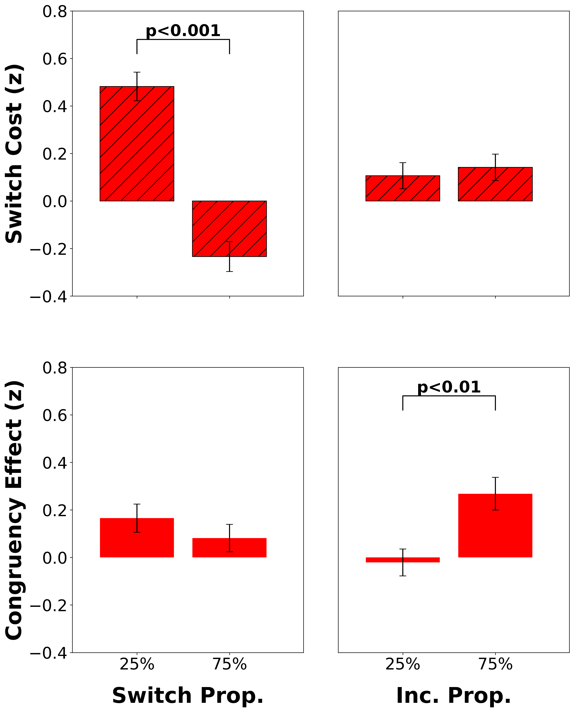

Intracranial EEG Correlates of Concurrent Demands on Cognitive Stability and Flexibility
Neural Correlates of Concurrent Demands on Cognitive
Stability and Flexibility
Jinjiang Zhang^{1,2}, Raphael Geddert^{1,2}, Roshni Ammanamanchi^{1,2}, Andrew Michael², Tobias Egner
Department of Psychology and Neuroscience¹, Center for Cognitive Neuroscience²
Duke University
Background
Behavioral Results
Cognitive stability (task focus) and flexibility (task switching) are two core capacities of cognitive control, yet their relationship and neural substrates are unclear^{1,2}
Previous studies have separately shown activation for stability and flexibility in lateral and medial frontal cortex^{3,4}, but whether they have distinct or shared neural substrates is still not known
Do cognitive stability and flexibility have distinct or shared neural substrates?
Listwide Proportion Switch Effect (LWPS): Switch proportion modulates switch cost
We identified brain regions mediating cognitive flexibility (via the LWPS) and probed their response to concurrent stability demands
dlPFC independently adjusts stability and flexibility
Neural Substrates of Flexibility³
Neural Substrates of Stability⁴
Incongruent proportion modulates congruency effect
Study Design
Brain Regions Modulating Flexibility
Participants completed a classic cued task switching experiment (n=45).
vlPFC adjusts flexibility
ACC independently adjusts stability and flexibility
Repeat
Switch
Red Frame: Odd or Even
2
7
1
…
Blue Frame:
< 5 or > 5
Congruent
Incongruent
< 5
even
> 5
odd
👉🏽
< 5
even
> 5
odd
👉🏽
👈🏽
👈🏽
Switch costs index flexibility (RT_{switch} – RT_{repeat})
Congruency effects index stability (RT_{inc} – RT_{con})
75%
Block A
64 Trials
Block B
64 Trials
The proportion of incongruent and switch trials varied independently across block types (2 blocks per functional run, 4 runs total)
Switch Prop.
25%
Block C
64 Trials
Block D
64 Trials
Discussion
25%
75%
Something about how lwps sensitive areas have their activity independently adjusted for stability and flexibility
Future work will also investigate the temporal differences between conditions
Incongruent Prop.
Analyses and standard preprocessing conducted in FSL.
Cluster-forming threshold of z=2.3 and cluster significance threshold of p=0.05.
Event-related modelling used for task conditions.
References/Acknowledgments
1. Egner 2023, Nat Rev Psychol. 2. Geddert and Egner 2022, Journal of Experimental Psychology. 3. Worringer et al. 2019, Brain Struct Funct. 4. Wu et al. 2020, J Comp Neurol. Thanks to all members of the Egner lab for their guidance and support on this project
This work was funded by NIH Grant RO1 MH133550
CONTACT
jim.zhang@duke.edu
CONTACT
jim.zhang@duke.edu

